Slide 1

7B Generator PAYE Submission Review

Slide 2

Context
Employer
Employee
Run Payroll
File Forms 5 every month
File Forms 2 in February
Print and/or distribute Form 7B
Receive 7B and verify details
File IIT Return & upload 7B

Slide 3
PAYE

Slide 4

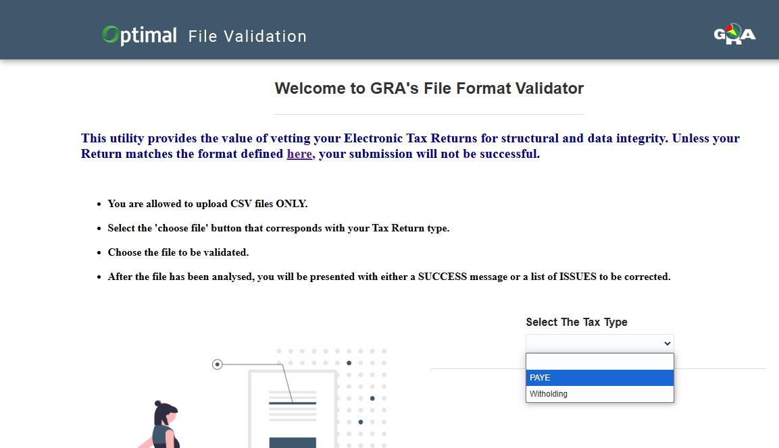


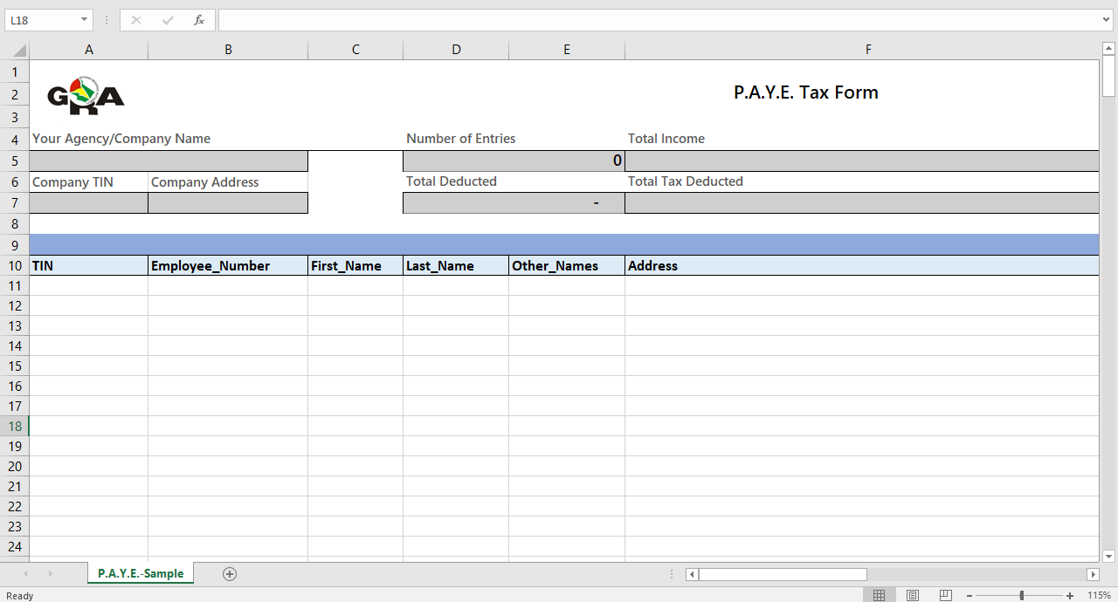
Payroll Software
File format validator
CSV
PAYE File Generator

Slide 5
Steps for Generating Forms 5 & Forms 2 CSV
Go to GRA’s website: https://www.gra.gov.gy/
Click on FORMS
Scroll to PAYE File Generator (Applicable from 2023)
Download & Extract zip file
Open with Excel & Ensure that Marcos are enabled
Click on the Enable Editing button
Click on the Enable Content button
Fill in details
Export csv file

Slide 6
Steps to Verify CSV
Go to GRA’s website: https://www.gra.gov.gy/
Click on Calculators and Tools
Click on File Format Validator
Select PAYE
Upload CSV file
Click on Validate
Resolve any identified errors and re-validate file

Slide 7
Steps to Submit Forms 5 and Forms 2
Go to eServices: https://eservices.gra.gov.gy/
Login
Go to File Return
Select PAYE for Forms 5 or PAYE Reconciliation for Forms 2
Upload CSV file
Resolve any identified errors and re-upload file
Tick the Declaration
Click on Submit

Slide 8
7B Generator

Slide 9
What
7B Generator application is a tool created by the GRA to assist employers with the generation and distribution of their annual 7B emolument slips.
Features
Generation of 7B emolument slips with the inclusion of a QR code.
The application will facilitate the disbursement of slips via email.
Prerequisite
Populate the 7B form template

Slide 10
Steps to populate 7B Generator Template
Go to GRA’s website: www.gra.gov.gy
Click on Individual or Business
Click on Pay As You Earn
Click on 7B Generator
Download 7B Generator template
Generate from Payroll or fill in the necessary details on the template
Save file

Slide 11
7B slip generator template

Slide 12
Steps to generate 7B emolument slips
Go to GRA’s website: https://www.gra.gov.gy/
Click on Calculators and Tools
Click on 7B Generator
Upload populated template to 7B Generator
Click on Upload file button
Click the pencil icon to make any correction to the 7B form if necessary and click on the Apply Changes button.
Click on Generate 7B Slip
Click on the Download Zip
Click on the Download 7B Slips
View 7B Form

Slide 13
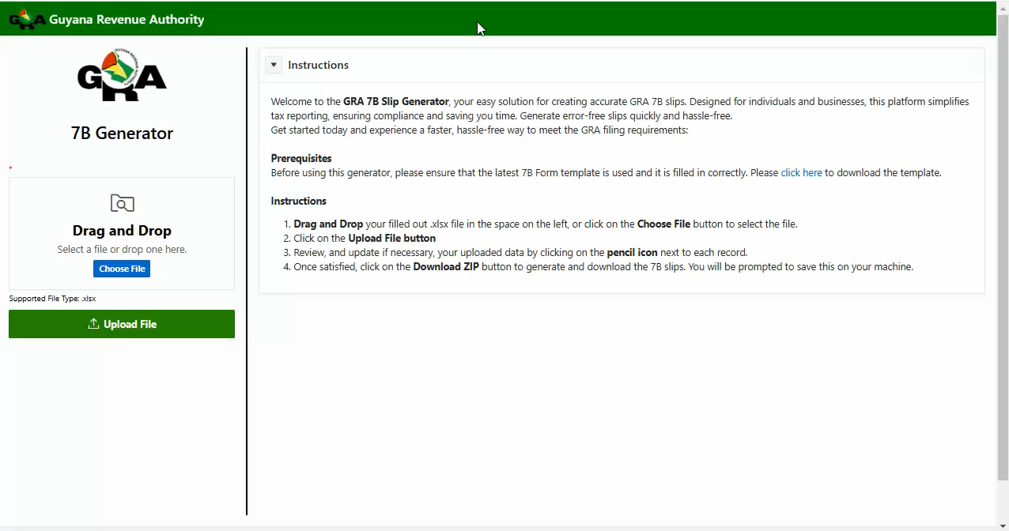

Slide 14

Questions

